Slide 1

AI Exam Preparation Assistant
Revolutionizing exam readiness through intelligent question generation and adaptive learning technology that transforms how students prepare for success.

Slide 2




Enhanced Confidence
Real-time feedback and progressive difficulty strengthens student self-assurance before exams.
The Challenge We're Solving
Problem Statement
Students face a critical challenge in exam preparation: generic practice materials that fail to adapt to their individual learning needs and knowledge gaps. Traditional study methods lack the personalization required for optimal learning outcomes.
Targeted Practice
Focused preparation on specific weak areas accelerates learning and builds mastery efficiently.
Our AI-powered solution generates targeted practice questions and provides instant evaluation, creating a dynamic learning experience that evolves with each student's progress.
Performance Insights
Data-driven analytics reveal learning patterns and guide strategic study decisions.

Slide 3

Why This Matters
Targeted Practice
Enhanced Confidence
Open Educational Question Banks
Focused preparation on specific weak areas accelerates learning and builds mastery efficiently.
Real-time feedback and progressive difficulty strengthens student self-assurance before exams.
Comprehensive repositories of validated academic questions across multiple subjects and difficulty levels, providing diverse training data for our AI models.
API - Gemini
Curated collections of real-world exam questions and student performance data, enabling our system to understand patterns in successful learning.
Performance Insights
Data-driven analytics reveal learning patterns and guide strategic study decisions.

Slide 4



Intelligent Question Generation
AI-powered system creates contextually relevant practice questions tailored to specific topics and learning objectives, ensuring comprehensive coverage of exam material.
Instant Response Evaluation
Advanced natural language processing evaluates student answers in real-time, providing immediate feedback on accuracy, comprehension, and areas requiring improvement.
Our Technical Foundation
Datasets Powering Intelligence
Open Educational Question Banks
Comprehensive repositories of validated academic questions across multiple subjects and difficulty levels, providing diverse training data for our AI models.
API - Gemini
Curated collections of real-world exam questions and student performance data, enabling our system to understand patterns in successful learning.

Slide 5

Prototype Capabilities
01
Intelligent Question Generation
Adaptive Difficulty Engine
AI-powered system creates contextually relevant practice questions tailored to specific topics and learning objectives, ensuring comprehensive coverage of exam material.
Dynamically adjusts question complexity based on student performance, ensuring optimal challenge levels that promote growth without overwhelming learners.
02
Instant Response Evaluation
Advanced natural language processing evaluates student answers in real-time, providing immediate feedback on accuracy, comprehension, and areas requiring improvement.
Performance Analytics Dashboard
Comprehensive insights tracking progress over time, identifying knowledge gaps, and recommending personalized study strategies for maximum exam success.

Slide 6
Full Solution Vision
01
Adaptive Difficulty Engine
Dynamically adjusts question complexity based on student performance, ensuring optimal challenge levels that promote growth without overwhelming learners.
02
Performance Analytics Dashboard
Comprehensive insights tracking progress over time, identifying knowledge gaps, and recommending personalized study strategies for maximum exam success.

Slide 7
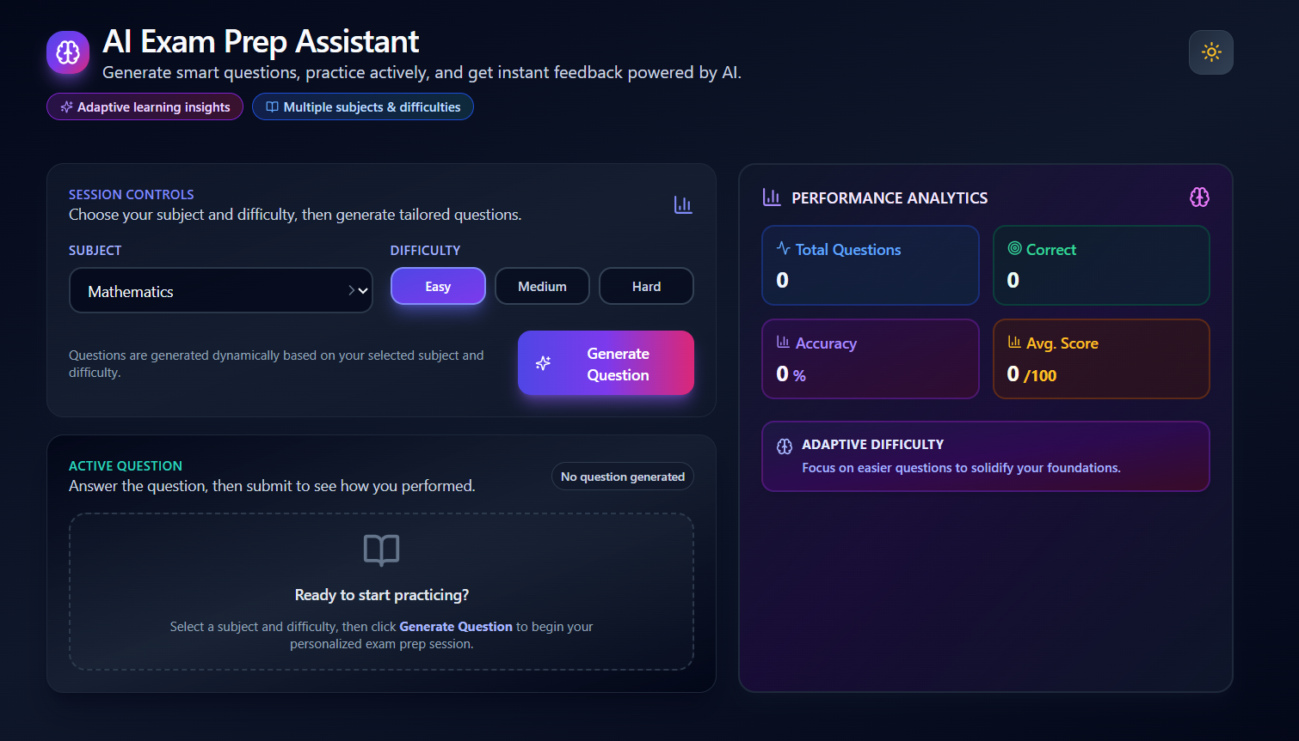



Our Solution:
LLM Question Generation
Feedback Generation
Large language models trained on educational content create diverse, high-quality practice questions across subjects and difficulty levels.
Intelligent systems deliver personalized, constructive feedback that guides students toward correct understanding and improved performance.
Automated Evaluation
Sophisticated NLP algorithms assess answer quality, detect misconceptions, and provide nuanced scoring beyond simple right or wrong.

Slide 8
Technical Architecture
LLM Question Generation
Automated Evaluation
Feedback Generation
Large language models trained on educational content create diverse, high-quality practice questions across subjects and difficulty levels.
Sophisticated NLP algorithms assess answer quality, detect misconceptions, and provide nuanced scoring beyond simple right or wrong.
Intelligent systems deliver personalized, constructive feedback that guides students toward correct understanding and improved performance.

Slide 9
Our Implementation Journey
Dataset Integration
Prototype Testing
Curated and processed educational question banks and exam datasets to build robust training foundation.
Validated system performance with real student interactions and refined based on feedback.
1
2
3
4
AI Model Development
Full Deployment
Trained and fine-tuned question generation and evaluation models for accuracy and relevance.
Scaled solution with adaptive features and comprehensive analytics for enhanced learning outcomes.

Slide 10

Impact & Results
3X
85%
40%
Practice Efficiency
Confidence Increase
Time Saved
Reduction in study time needed to achieve mastery through intelligent question targeting.
Students complete three times more targeted practice with adaptive difficulty adjustment.
Students report significantly higher confidence levels before exams after using our platform.

Slide 11
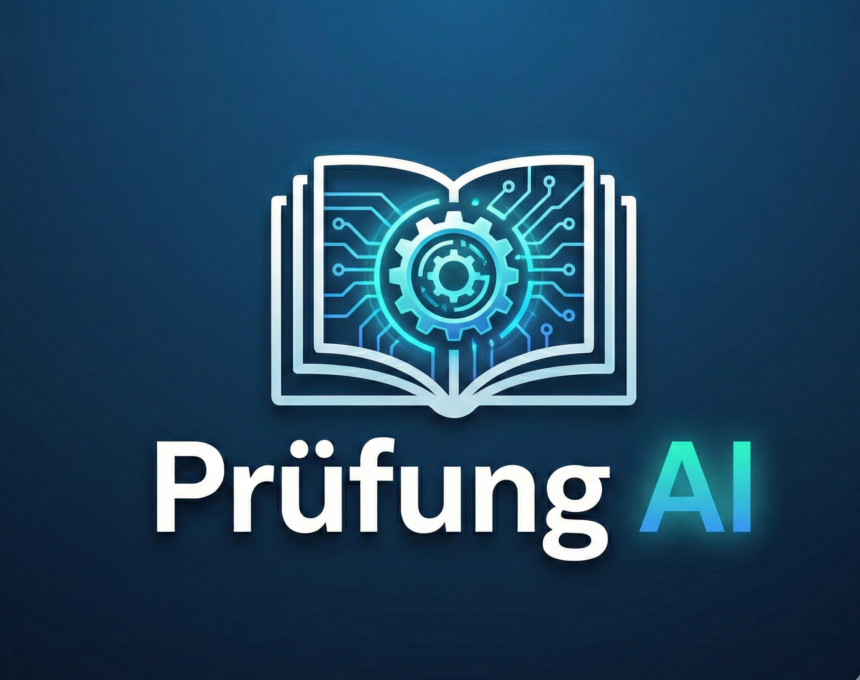
Thank You
Empowering Students Through Intelligent AI
Our AI Exam Preparation Assistant represents the future of personalized learning—where every student receives targeted support, adaptive challenges, and actionable insights to achieve their full potential.
"Wishing you all the very best for the hackathon. May your hard work, creativity, and teamwork lead you to great success."

